Slide 1
Oral Presentation Visual Displays
Prof. Krishna Misra,Ph.D., FNASc, FBRSI
Hon.Professor
Indian Institute of information Technology, Prayagraj
Dated November 9, 2021

Slide 2
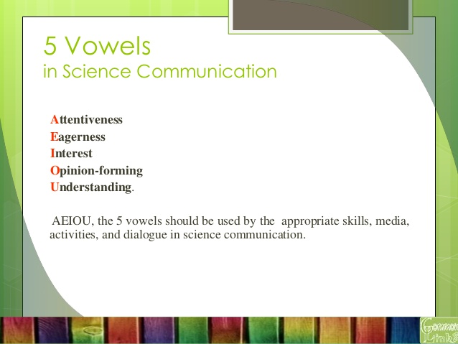

Slide 3
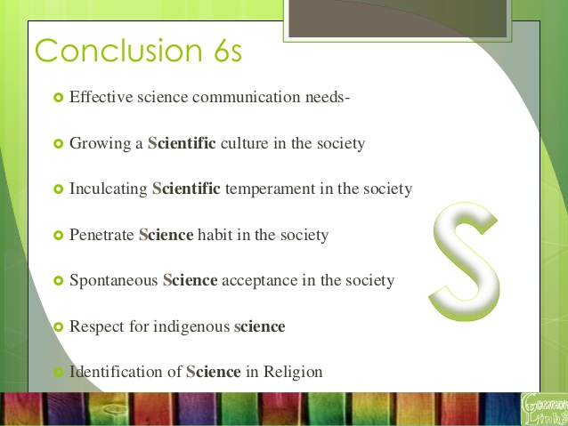

Slide 4
Difference between Conference, Seminar, Symposium , workshop & Congress
A SEMINAR is a lecture or presentation delivered by expert/s to an audience on a particular topic or set of topics that are educational in nature. It is usually held for groups of 10-50 individuals. The speaker highlights ,scope, importance, benefits & limitations of the topic.
A WORKSHOP is a series of educational and work sessions. Small groups of people meet together over a short period of time to concentrate on a defined area of concern. This is learning while working.
SYMPOSIUM is meeting of a number of experts in a particular field at which papers are presented by specialists on particular subjects and discussed with a view to making recommendations concerning the problems under discussion.

Slide 5
Conference and Congress
CONFERENCE is a prearranged meeting for consultation or exchange of information or discussion (especially one with a formal agenda). conference is like a official meeting where speakers directly interact with the audience i.e. like a brain storming session..
A congress is a formal meeting of the representatives of different countries, constituent states, organizations, trade unions, political parties or other groups.
Science Congress is an alternative name for a non political large national or international academic conference
The Science Congress association started in the year 1914 in Kolkata and it meets annually in the first week of January.
It has a membership of more than 30,000 scientists.
108th session of Indian Science Congress ill be held from 3-7th January, 2022 at Symbiosis International University, Pune.
Focal Theme - Science and Technology for "Sustainable Development with Women Empowerment".

Slide 6
Types of science communication
Two types of defined science communication are science ,
Science “Outreach” : typically conducted by professional scientists to non-expert audiences.
Science "inreach“:Expert to expert communication from similar or different scientific backgrounds.
Does one need specialist knowledge or training to do science communication?
‘No’. It is up to the science communicator to make sense of science in their own words and explain it in an intelligible way to others. Education or training in science helps .
A willingness to learn about technical or quantitative subjects, grasp of media skills and storytelling are useful tools in the science communicator’s toolbox.

Slide 7
How to prepare your abstract for the Conference
ABSTRACT TITLE
First AUTHOR¹, Second AUTHOR² and Third AUTHOR³
1. Department Name, Organization, Country; Email me@email.com
2. Department Name, Organization, Country
3.Organisation, Country

Slide 8
How to prepare your abstract for the Conference
Insert abstract text here and follow this format
The abstract is very important as it will be published in the Conference Proceedings and will be read by many people including those who did not attend the Conference.
It must be in English and should be concise and informative.
Use Arial 10 pt font and single line spacing throughout.
Place the title of your abstract in bold at the top
Leave 1 line and then add the names of the authors with the family name in upper case.
The name of the presenting author should be underlined.
Leave 1 line and then list the affiliations of the authors together with the email address of the corresponding author as shown.
Leave 1 line and type the content of your abstract.

Slide 9
Conference abstract contd……..
Text should be left justified with 1 space at the end of each sentence.
No references, tables, figures or any other graphics should be included.
Equations and symbols (mathematical and Greek etc) must be typed.
Symbols or the Greek word for the symbol may be used (for example, ∂18O or delta18O).
Do not use bold text or headings in the content of your abstract.
Please use metric measurements and symbols.
Avoid expressions such as “is discussed” and “is described”
The content of the abstract must be no longer than 250 words or as informed by organizers.

Slide 10
Oral presentation for all types of scientific meetings
New research findings/updated reviews of specific research areas can be presented before these are published in journals.
Every individual has his/her style of presentation and this variability adds to the quality of a meeting
A form (style) has to be adopted according to your personality and keeping the audience in mind.
The visuals which you show must be liked by the audience
It is important to make effort to perform a good presentation, not only for liking of the audience but for conveying your message efficiently. Audience should be able to understand the main points easily.
Considering the hard work you have put in research , it becomes eminent that these should be communicated for spreading knowledge .
A good presenter makes good contacts, which helps you in furthering your research

Slide 11
Adapt to Audience
Adopting to audience is more important in oral presentation than in written communication
Audience cannot go back as in written text, therefore think ahead about the background, interests and capabilities of your audience.
Keeping in mind the diversity of your audience regarding your topic, your presentation should be more general than written paper.
However, do,nt loose in depth coverage of your topic.
“Presentation “ implies that you are giving “present” to your audience which they should like and cherish.
The value of your gift is enhanced if you deliver it personally.

Slide 12
Who?-Why?-What?-How?
Who are you addressing? scientists (specialists or wider group)students or general public?
Why is your message important? It is not just for credit but for enhancing the pool of knowledge.
What is your main finding or “take home” message?
Is it new research or review of a topic ? What prior
knowledge or questions your audience might have?
How can you best deliver your message and satisfy the audience needs? How will the audience use it as new knowledge

Slide 13
Preparing Oral Presentation
While preparing your presentation think how to structure the topic so that audience remember your main message.
Audience attention is highest at the beginning and also at the end. In the beginning audience is curious to know what is coming and at the end anticipating your conclusions.
It is in the middle of the lecture that you have to maintain interest.
Important messages should be repeated , since audience might miss some.
Give the audience the take home message when their attention is highest

Slide 14
The human factor during public speech
When at a loss how to go on cough (Greek proverb)
Every oral presentation has three major facets, content, design and delivery.
Quality of each affects the overall quality of presentation.
Good content and good organization makes the speaker to deliver confidently.
If the talk is poorly designed even with polished delivery it will be difficult for the audience to understand.
Most people get nervous while facing the audience, resulting in the release of adrenaline.
Nervousness can be controlled /minimized mainly in two ways.
(i) Change your state of mind
or(ii) prepare, organize and deliver the presentation in such ways which reduce anxiety

Slide 15
Prepare for audience questions
While preparing your presentation think about what questions your audience may ask and incorporate answers in your presentation
This will improve quality of your presentation, make it more adopted to audience and prepare you for answering their questions
If audience is mixed , generalists will like to know how your results are beneficial for them and specialists will like to know in depth about methodology. So be prepared and be brief in your response

Slide 16
Make presentation outline
In order to plan your content according to the allotted time develop presentation outline
Presentation should be in a simple clear language (native or foreign).
Outlining of presentation depends on subject, audience and your personality.
The same principles apply here as for written communication
Start with a historical background and objectives followed by materials methods results, discussion and conclusions and modify according to audience needs

Slide 17
General Structure for Presentation
Title
Introduction
Results (main body)
Summary and conclusion
Title must be catchy (informative and inviting or even provocative)to attract people to your presentation. It is given in meeting’s schedule therefore is most important.

Slide 18
Introduction
Introduce your subject in a most lucid manner to take advantage of higher level of audience attention
Tell your audience in the very beginning what take home message you are going to give them ,so that they listen to your presentation with attention.
Another approach is to start asking questions which you anticipated they may ask.

Slide 19
Results (Main body)
This is the main part of your talk
Structure content logically
Make it interesting by relating to audience
Give common realistic examples, analogies to answer some of the questions formulated by you
Give advantages/disadvantages of some of the solutions.
Divide the whole work under subsections and structure each one briefly and logically
For specialized audience give methodology first followed with results otherwise for interest-importance approach straightaway come to results.
To retain audience attention take help of visual aids, body language and voice modulation
In workshops and seminars you can ask questions in between

Slide 20
Summary and Conclusions
This is most important since it is mainly the take-home message.
Discuss here about the impact of your work and give your recommendations.
Adjust timing of your presentation in a way that you do’nt miss this part.
Make this part crisp and concise
Acknowledge your co-workers at the end.
Exit strategy is important

Slide 21
Performing the oral presentation
Oral presentation can be performed in different ways.
Choose appropriate type of visual according to availability.
Keep room lights on as much as possible(prepare visuals accordingly).
Well lit room helps you to keep eye contact with audience and vice versa
You can look into your notes and audience can also take notes
but keep eye contact with audience

Slide 22
Performing the oral presentation…………
Put colours into visuals and contrast (light background) , so that these are visible clearly even in presence of light, otherwise give instructions to put on the lights as soon as visual seeing is on. Stand by the lectern or when away from it use your body language.
You may also move around while explaining.
It is better to speak while standing. In special case you may talk while sitting also.
Use style according to your personality but keep eye contact with audience

Slide 23
Points to keep in mind while showing visuals
Do’nt turn your back at audience while pointing at the screen.(Use a stick or Laser pointer).
Do,nt look at computer screen or projection screen constantly, switch alternately (do,nt loose eye contact with audience).
Use remote control or cordless mouse to change slides while standing away from lectern.
In case of overhead projector cover the surface while not in use to avoid bright light.
Do,nt block the audience view of visuals by standing in between.
Your voice in important in your presentation. Speak clearly, not too fast or too slow.
Using microphone modulate your voice.
Dress to keep battery of cordless microphone in your pocket

Slide 24
Visual Communication (Aids)
How can I know what I’ve said until I see what I’m saying
Visual communication has both,
(i) A visual component(visual presentation of the written word)
(ii)Illustrative component e.g drawings, photos, charts, figures, tables etc.
When people look at a visual pattern ,they process it differently than text (Oral presentations for technical communication;by Laura J Gurak ;Publisher:Allyn and Bacon, ©2000).
Humans read each word of text and decipher it but they quickly and efficiently perceive visual information as a unit.
Many times when you puzzle over text you turn to diagram.

Slide 25
Visual Communication (Contd)
Use of symbols rather than written words can make concepts more understandable globally.
Web publishing has given visual communication greater force and global presence
Presentation softwares have made Graphics easy to generate which once took hours or days
The visual communication has become a basic part of almost all effective scientific presentations
Traditionally the most popular visual aids have been 35 mm slides, overhead transparencies, flipcharts, films, videotapes, filmstrips ,chalk board or marker board

Slide 26
Visuals support your talk
Audience absorb more information through visuals and retain that information longer
Visuals should be clear and meaningful to the audience.
These should relate to the words spoken , be well organized and emphasize important points
Power point is the most professional means of presentation (contradiction)

Slide 27
Keep to time, rehearse
Rehearsal is key for a successful presentation
You should keep to the time allotted
Rehearse in front of a mirror or ask a colleague to listen to you
Use a video or a tape recorder
Practice using a timer

Slide 28
Coping with questions
You can predict some questions and prepare extra visuals and slides
Your answers to questions should be brief and to the point, leaving room for other questions
Do,nt start a new lecture
If you do,nt know the answer say that you will find out.
Let the whole audience listen to the question and your answer

Slide 29
An Example of Oral presentation
Good morning Ladies and gentlemen,
it gives me great pleasure to be here this morning. My name is ……… I am a graduate student of Faculty of Science, IIIT Prayagraj, India . My presentation includes results of my research on A novel cost effective method of Prognosis of pancreatic cancer …………I have divided my talk in three parts , Firstly I am going to speak about………,then …… and shall conclude with …..(Give take home message here).My presentation will last for 45 minutes. In case you have any questions ,please save them at the end of my presentation

Slide 30
THANK YOU

